Slide 1
Longest Path Approximation

Slide 2
Approximation Explanation
Type: Random
Randomly pick a starting vertex
Randomly traverse unvisited vertices
Stop when there is no more possible traversal
Repeat steps 1-3 many times
Save the longest path seen

Slide 3
Pseudocode
longest = 0
for _ in range(2n):
u = random vertex
next = [u] + traverse(graph, weights, u, set())
longest = max(longest, next)
def traverse(graph, weights, u, visited):
poss = []
visited.add(u)
for v in graph[u]:
if v is unvisited:
poss.add(v)
if poss is empty
return []
v = random vertex from poss
return [v] + traverse(graph, weights, v, visited)

Slide 4
Runtime Analysis
The approximation algorithm runs in polynomial O(n^2).
The algorithm is run 2n times to account for the randomness, and the best result is taken:
“for _ in range(2n):”
Within the algorithm, it can recurse n times in the worst case, as it traverses down a single path which could be the entire graph:
“for v in graph[u]:”
…“return [v] + traverse(graph, weights, v, visited)”

Slide 5
Lower Bound
There is no guarantee of accuracy with this approximation. Although, as long as there is at least 1 path in the graph, the algorithm will find a path. This is because it selects a starting node from the list of nodes that have at least one outward edge. However, the weight of that path could be infinitely small. Assuming all weights are positive, the only lower bound would be > 0.
The approximation does really terribly on dense inputs with few long paths. On a graph of 52 nodes, I was able to get it to find only lengths of 1 and 2 most of the time when there existed a length of 10000.

Slide 6
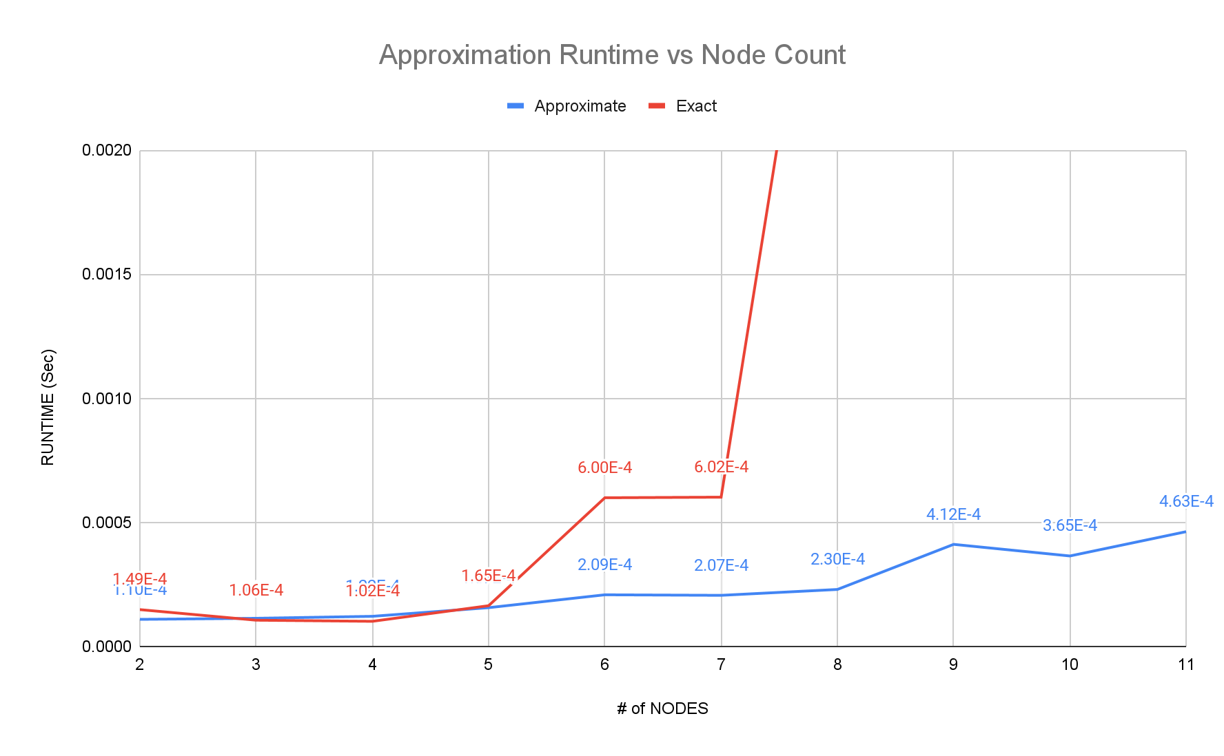
Runtime Comparisons
As you can see, the approximation algorithm grows at a drastically slower rate than the exact solution, with 11 inputs not even being solvable with our solution.

Slide 7
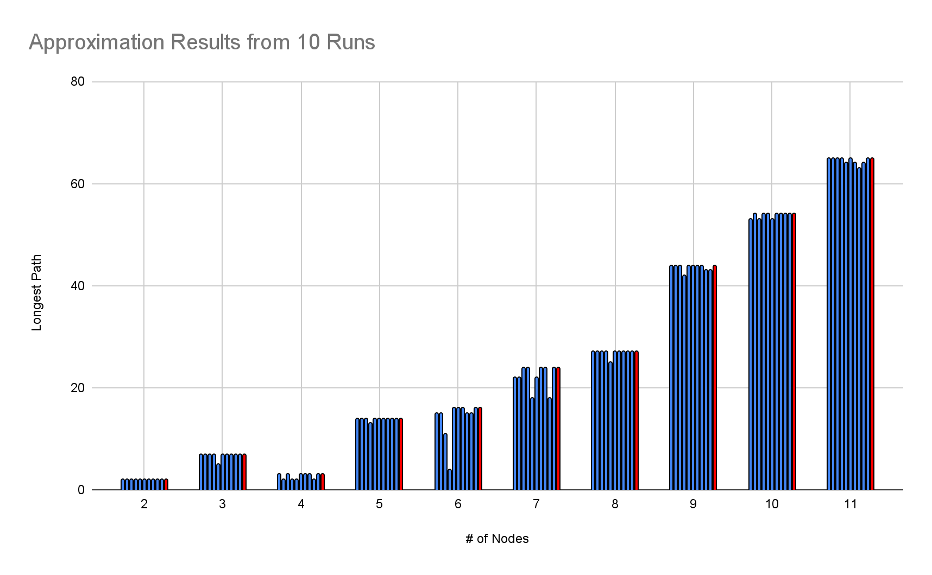
Result Comparisons
As shown, the approximation algorithm is somewhat consistent on our test inputs, but still not every run produced the same result.
Blue are approximations
Red is the exact solution

